Slide 1

Advances in mutation testing: novel samples and new methodologies
Professor Ian A Cree
Warwick Medical School
i.a.cree@warwick.ac.uk

Slide 2
One size fits all?
Treatment A > B
All get A in future
A
B

Slide 3
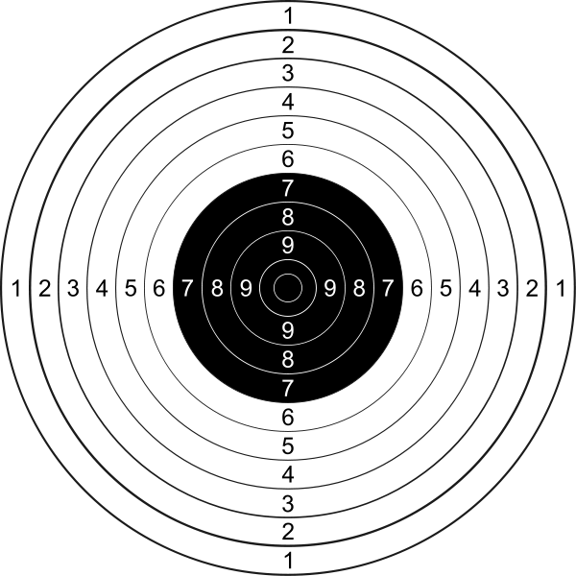
Standards – Analytical
Pre-analytical handling?
Right test for the patient?
Right turnaround time?
Reflex testing?
Right technology?
Accuracy and precision?
Quality controls met?

Slide 4
Overview
EGFR mutations and beyond…
Pre-analytical issues
Techniques in clinical practice
New methods for mutation testing
Alternative samples for mutation testing
Implications – colorectal cancer
Notes:
The main aim of this talk is to discuss the evolving methods used to test lung cancers for mutations as companion diagnostic tests for drugs active against lung cancers. The pace of change is considerable, and it is quite likely that data presented at this conference or known to those in this room could change things further.

Slide 5
Overview
EGFR mutations and beyond…
Pre-analytical issues
Techniques in clinical practice
New methods for mutation testing
Alternative samples for mutation testing
Implications – colorectal cancer
Notes:
Others in this session will talk about the genetics of lung cancer in more depth, but following the realisation that EGFR mutation status could guide the use of EGFR tyrosine kinase inhibitors, such as gefitinib, the search was on for other targets.

Slide 6
Lung cancer genetics – increasing complexity
After Dearden et al., Ann Oncol 2013.
Notes:
The result is increasing complexity – this pie chart shows how different populations of NSCLC can be divided by their genetics into different groups based on the EGFR and related pathways. Two points are worth making here:
The numbers vary by country – in the UK we have only around 10% EGFR positivity in adenocarcinomas and a much higher number of KRAS mutant tumours NRAS mutations have also been reported.
There are still a large number of patients with NO activating mutation likely to be susceptible to therapy – so what is going on there? Epigenetics may be an answer, and will of course need different assays, so this is a challenge.

Slide 7
Lung cancer genetics – increasing complexity
After Dearden et al., Ann Oncol 2013.
Notes:
This is the chart for asian NSCLC – clearly there are many more patients with EGFR mutations, but the remainder add up to a considerable percentage.

Slide 8
Lung cancer genetics – increasing complexity
After Dearden et al., Ann Oncol 2013.
Notes:
The other point is that Squamous Cell Carcinomas have significant numbers of patients with treatable mutations.

Slide 9
gefitinib
erlotinib
afatinib
Icotinib
cetuximab
onartuzumab
bevacizumab
EGF
HGF
IGF
VEGF
trastuzumab
HER
MET
IGFR
VEGFR
crizotinib
EML-ALK4
RAF
RAS
PI3K
PTEN
selumetinib
MEK
AKT
ERK
HIF1α
mTOR
p70 S6K
everolimus
sirolimus
Growth
Apoptosis
Angiogenesis
Notes:
Until a year or two ago, at least in the UK, only EGFR mutation really mattered as drugs were not available to treat other mutations. How things have changed! There are now several choices of small molecule for patients with EGFR mutations, and afatinib is a pan-HER inhibitor which even hits the T790M resistance mutation. Antibodies are worth a mention – in combination it appears that cetuximab may have activity, bevacizumab has been used with success, and HER2 amplified cases have responded to trastuzumab (Herceptin). Crizotinin is well established for EML-ALK tumours, and selumetinib is an interesting MEK inhibitior showing promise in patients with RAS mutations – a large proportion of NSCLC.
There are other agents in the pipeline, though currently without published phase II data – small molecule Akt inhibitors and Met inhibitors in particular. The trick is likely to be in combining these drugs intelligently for individual patients, and handling resistance mechanisms too. This will need to be matched by increasingly sophisticated diagnostic strategies.

Slide 10
Overview
EGFR mutations and beyond…
Pre-analytical issues
Techniques in clinical practice
New methods for mutation testing
Alternative samples for mutation testing
Implications – colorectal cancer
Notes:
The forgotten part of the puzzle is the pre-analytical handling of the specimen which can make an enormous difference – so let’s think about the sample rather than the patient pathway for a minute.

Slide 11
Sample pathway
Surgeon
Patient is main concern
Nurse
Not main job
Porter
Variable availability
Specimen pot
Labelling and request
Ensures dispatch
Time is not an issue…
Pathology Reception
Home at last?

Slide 12
Tissue selection
Histopathologist’s input is critical – is there any cancer in the sample you’re testing?
Microdissection – handle with care…
Define the % neoplastic cells – not % tumour!

Slide 13
DNA extraction
Multiple methods available:
  Filter-based
  Magnetic beads
MaxwellTM (Promega) – automated extraction from FFPE punches or sections/scrapings
DNA content – NanodropTM, QubitTM
FFPE, formalin-fixed paraffin-embedded

Slide 14
Overview
EGFR mutations and beyond…
Pre-analytical issues
Techniques in clinical practice
New methods for mutation testing
Alternative samples for mutation testing
Implications – colorectal cancer
Notes:
Once you have your DNA, you can start looking for mutations. There are a host of methods out there (next slide)

Slide 15
Current methods for mutation testing
Sequencing
  Sanger, Pyrosequencing, next-generation
  All demand considerable molecular expertise, but coverage of possible mutations is better
PCR
  Keep it simple!
  cobas (Roche) and Therascreen (Qiagen) are popular and cover most of the mutations for which clinical response is established
PCR, polymerase chain reaction
Notes:
The methods can be divided into two main types – PCR based methods are simple and cover most of the mutations for which the clinical response is well known, but sequencing has better coverage. The choice depends on lab facilities, staff, and budget.

Slide 16
Molecular analysis of EGFR in NSCLC EQA
ARMS, amplification refractory mutation system; EQA, external quality assurance; HRM, high resolution melt; PCR, polymerase chain reaction
Notes:
These are data from UK NEQAS showing which methods are in use in laboratories doing EGFR testing. Only around 50% of the labs are within the UK, the rest are in various parts of the world, though mainly Europe.
Sequencing remains popular, as do the PCR methods – but the big change is the adoption of the cobas (Roche) PCR method. This is an extremely simple

Slide 17
Overview
EGFR mutations and beyond…
Pre-analytical issues
Techniques in clinical practice
New methods for mutation testing
Alternative samples for mutation testing
Implications – colorectal cancer
Notes:
New methods are worthy of a talk in their own right, so this is a rapid overview of some that interest me particularly – it is a personal view and apologies to anyone here who has a new method I don’t mention!

Slide 18
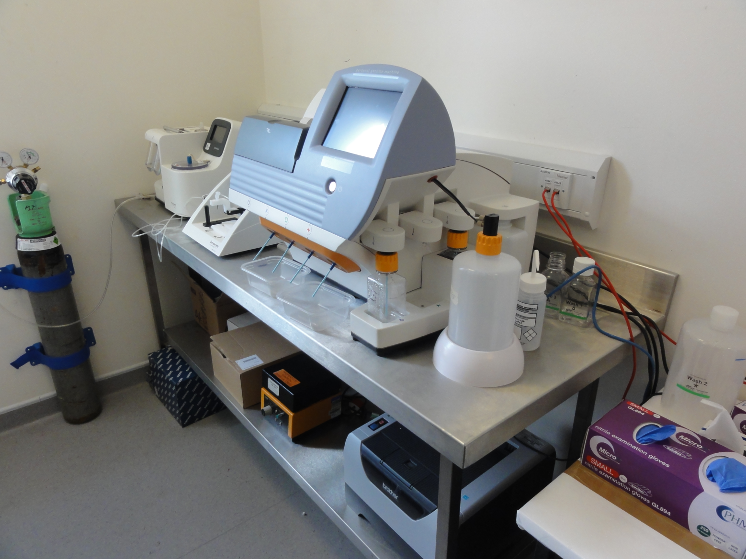
IonTorrent next-generation sequencing
Notes:
Next-generation sequencing has to be the up and coming technology. This instrument is in my lab, so I’m bound to talk about it, but others use the Illumina MiSeq and are reporting good results. We are not yet using this for reporting results on patients, though others are.

Slide 19
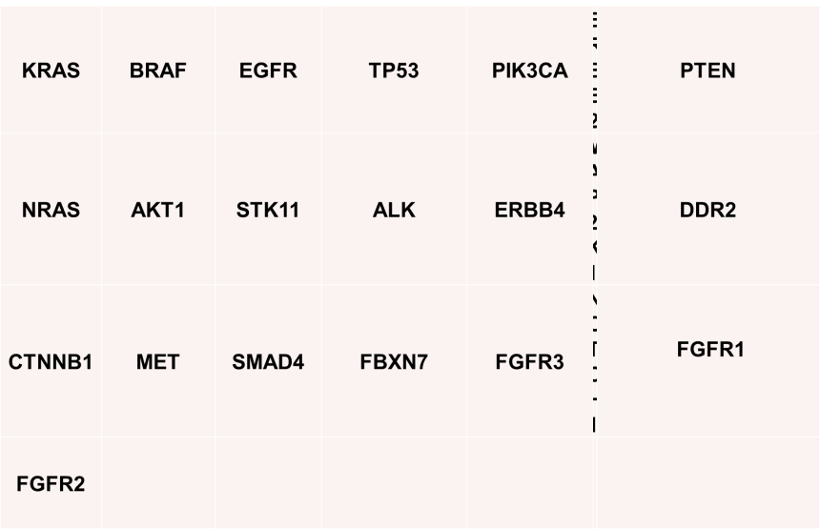
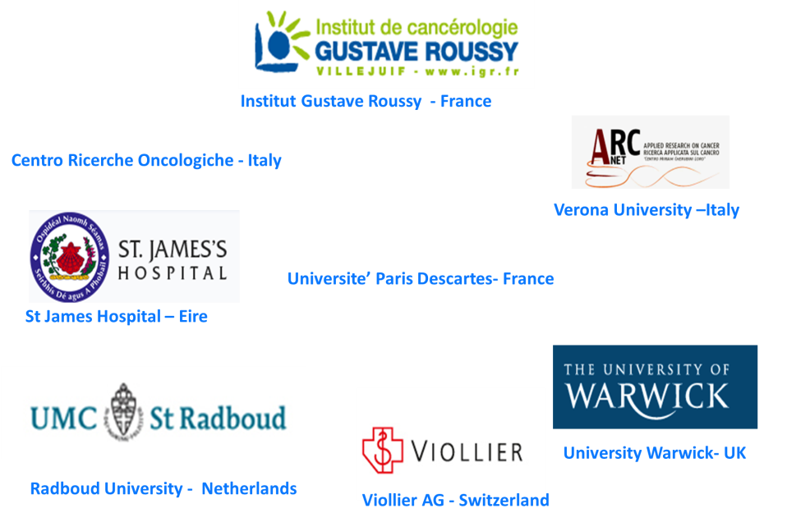
OncoNetwork Consortium: a European Collaborative Research study on the development of a colon and lung cancer genes hot spot panel with Ion AmpliSeq™ technology on the Ion PGM™ sequencer
www.invitrogen.com
Notes:
We are one of the labs involved in the OncoNetwork collaboration which has produced analytical validation for a 22 gene panel that includes all the hot spots in which mutations occur for genes of interest in lung and colorectal cancer. Clearly, many of these do not (yet) have companion drugs to go with them, but the expectation is that knowledge of these mutations will help patients. We are now putting this through a clinical validation process to enable us to use it clinically with an accredited laboratory – without this it remains a useful research tool, but only that.

Slide 20
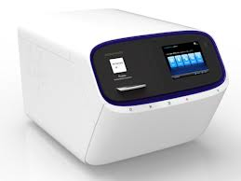
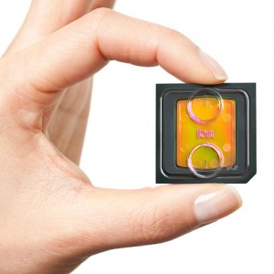
Whole Genome Sequencing
P1 chip – 165 million sensors
£1,000 genome by end of year

Slide 21
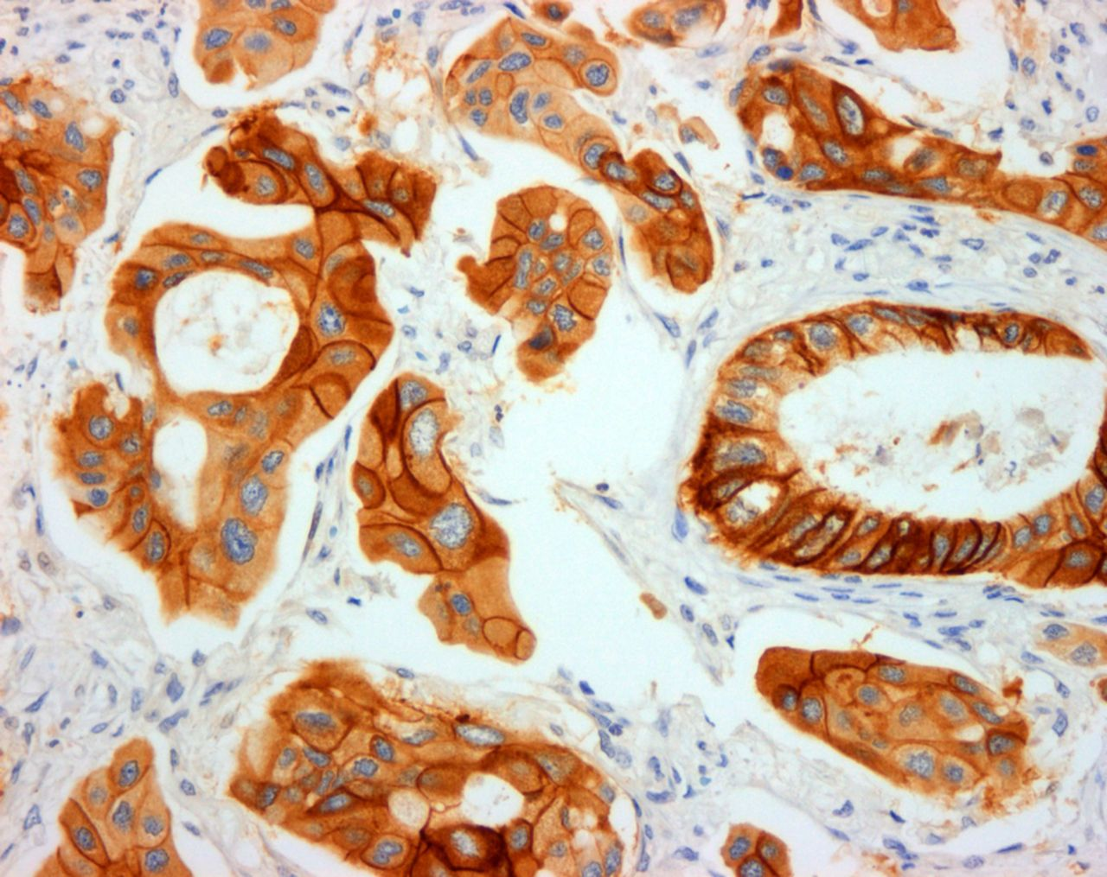

Adenocarcinoma with positive staining for EGFR exon 21 L858R mutation-specific antibody (x200)
Cooper W A et al. J Clin Pathol Published Online First: 11 June 2013 doi:10.1136/jclinpath-2013-201607
Copyright © by the BMJ Publishing Group Ltd & Association of Clinical Pathologists. All rights reserved.
Notes:
Adenocarcinoma with positive staining for EGFR exon 21 L858R mutation-specific antibody (×200). Mass spectrometry demonstrated L858R mutation in this case.
New methods are available from DNA to protein as mutations result in altered proteins, so it is possible to use antibodies to detect mutations.

Slide 22
Introducing new assays
Analytical validation – is it true?
Clinical validation – is it meaningful?
Clinical utility – is it useful?
  Health outcome
  Effect on patient pathways
  Health economic modelling
  Direct comparison with current technology
  Incremental change in test vs current practice
Quality assurance and accreditation

Slide 23
Overview
EGFR mutations and beyond…
Pre-analytical issues
Techniques in clinical practice
New methods for mutation testing
Alternative samples for mutation testing
Implications – colorectal cancer
Notes:
I’m going to end by talking about alternative samples, rather than laboratory methods. Those of you who went to AACR will realise that Liquid Biopsy is now big news, though many of us have expected that this would be feasible.

Slide 24
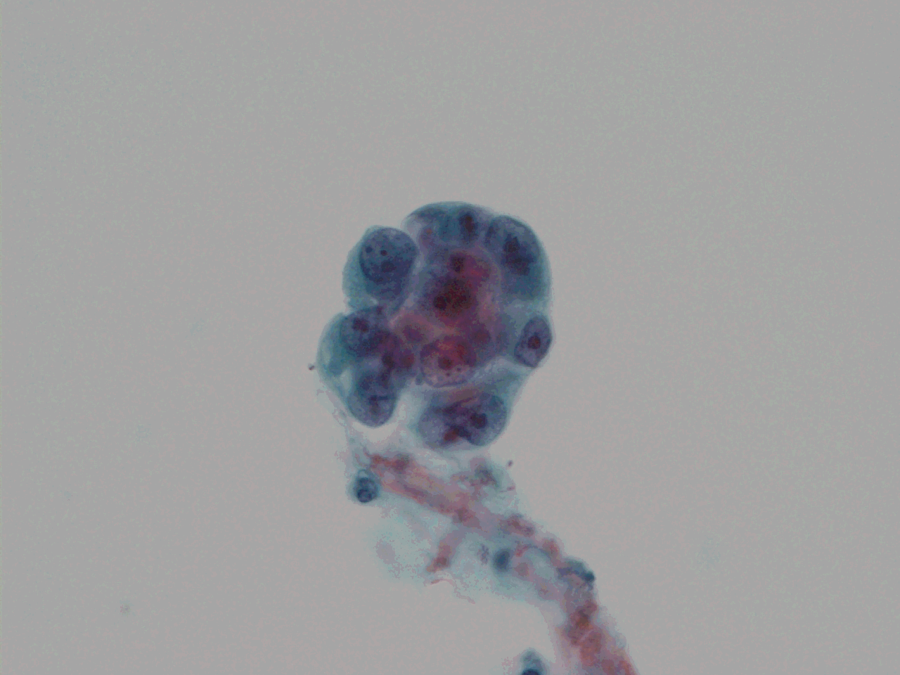
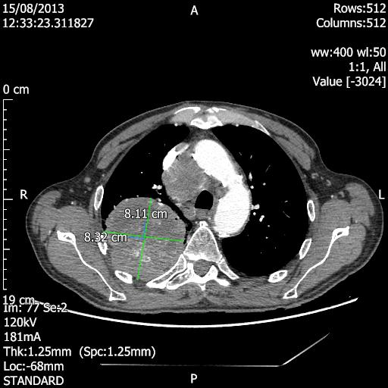
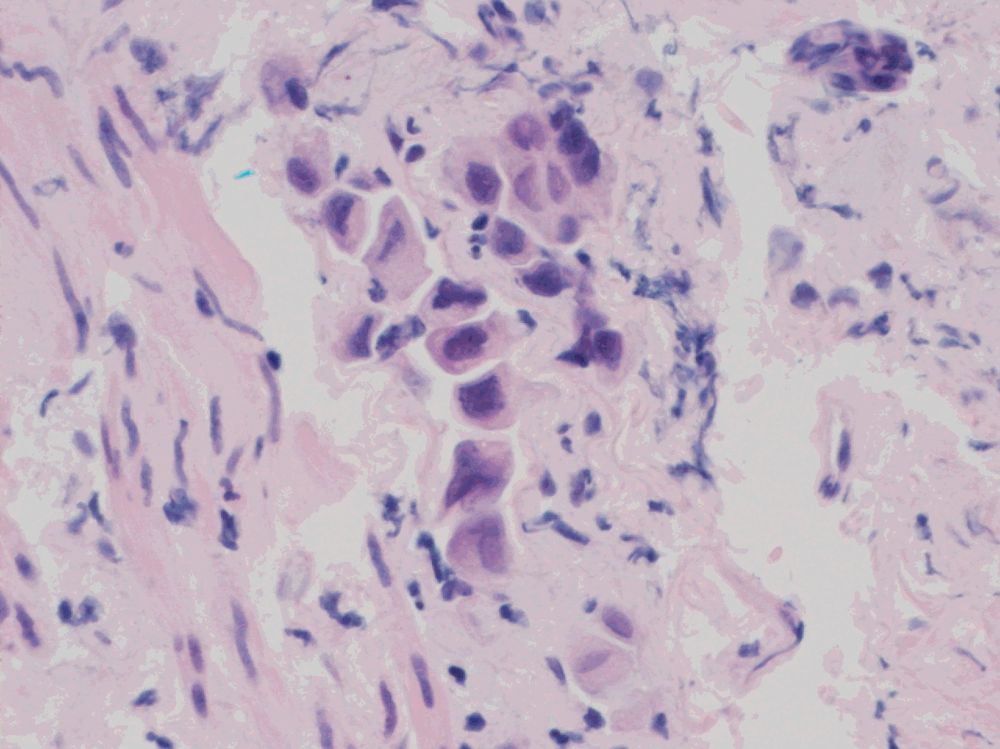
Size matters?
Notes:
This is the problem – the cancer is large, and the biopsy is usually very small and not representative.

Slide 25

Mutations,
methylation
Metabolic
changes
Cytokines
& receptors
Protein degradation
products
miRNA
Growth
DNA fragments
Cell death
Tumour
Angiogenesis
Circulating
endothelial cells
Invasion &
metastasis
Exosomes
Antigenicity
Y
Y
Circulating
tumour cells
Y
Y
Auto-antibodies
Collagen degradation
products
Immune response
Cree IA. Improved blood tests for cancer screening: general or specific? BMC Cancer. 2011; 11: 499
Notes:
Cancers produce many potential analytes into blood, and that includes DNA, in which one can detect mutations.

Slide 26
Plasma ctDNA
Detection of EGFR mutations in circulating tumour DNA in the blood plasma or serum of NSCLC cancer patients is feasible
This can overcome:
  Known heterogeneity of mutations within tumours
  Lack of tissue availability from patients
  Development of new mutations during tumour progression
Methods now include targeted or even whole exome next generation sequencing
Notes:
Plasma is the best source of circulating tumour DNA. There are now over 60 published studies showing that this works: the latest recently published in Nature used next generation exome sequencing to show the evolution of mutations in lung cancers under treatment with both targeted and cytotoxic agents.

Slide 27
Overview
EGFR mutations and beyond…
Pre-analytical issues
Techniques in clinical practice
New methods for mutation testing
Alternative samples for mutation testing
Implications – colorectal cancer
Notes:
I’m going to end by talking about alternative samples, rather than laboratory methods. Those of you who went to AACR will realise that Liquid Biopsy is now big news, though many of us have expected that this would be feasible.

Slide 28
Colorectal Cancer
Colorectal cancers (CRC) use the EGFR pathway to grow
CRC express EGFR protein but activating mutations are rare and small molecule inhibitors are not active
However, antibodies against the extracellular domain of EGFR are active
Downstream mutations in signalling pathways can alter the sensitivity of CRC to EGFR antibodies
Mutations in KRAS and probably BRAF are common known examples

Slide 29
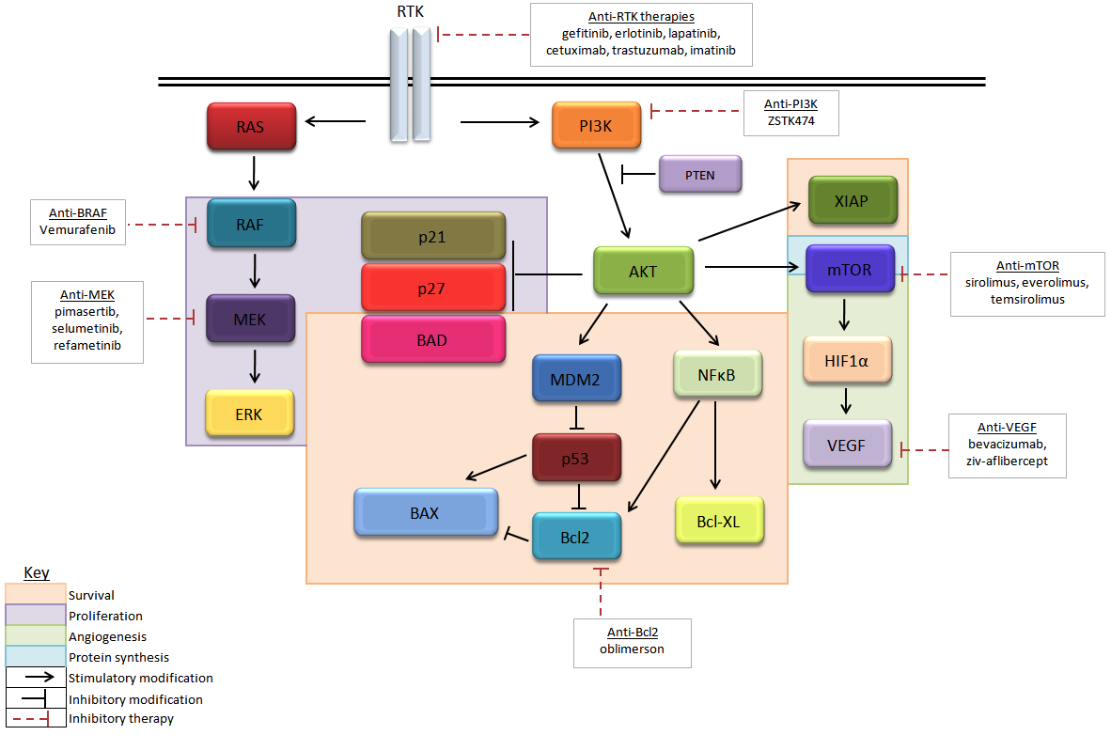
EGFR pathway

Slide 30
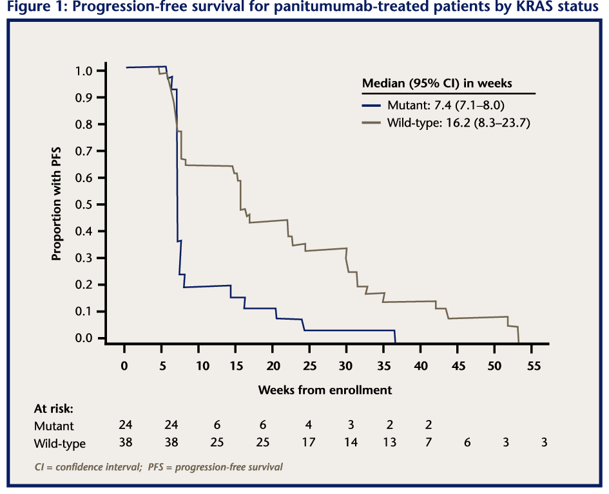
http://www.newevidence.com/oncology/entries/Panitumumab_response_is_dependent_on_KRAS/

Slide 31
Testing Strategy
(Di Nicolantonio et al., PLOS One 2009)

Slide 32
UK KRAS testing rates lag far behind our EU peers
Proportion of mCRC patients receiving a KRAS test in the last 6 months
2011
2012
% of physicians
Cumulative
Cumulative
Q17: What percentage of your mCRC patients have had a KRAS test in the last 6 months? (Base: EU4 oncology sample, 2011=358, 2012=350)
Source 2012 KRAS biomarker survey – The Research Partnership November 2012

Slide 33
Testing and Chemotherapy
Cetuximab
Bevacizumab
No MAB
Panitumumab
Cetuximab
Bevacizumab
No MAB
Panitumumab
Cetuximab
Bevacizumab
No MAB
Panitumumab
% of patients
Base: All patients (320)
Q.230 KRAS outcome Q.272 Which chemotherapy treatment (cytotoxic and/or targeted therapy) does this patient currently take?
Notes:
Cool colours. Do not know between the two catagories.

Slide 34
Conclusions
Molecular analysis of cancer is required to optimise patient treatment
Pre-analytical issues are a major concern
There is a wide choice of analytical method – but quality must be assured
New methods such as next generation sequencing show immense promise for the future
Liquid biopsy is coming of age and will change
practice – it will enable oncologists to use drugs intelligently to combat changes in individual cancers as they happen

Slide 35


Thank you!
David Snead
Judith Timms
Anne Reiman

