Slide 1
Coronary Artery Calcium
…what it means for you and your patient
Notes:
Thank you for the opportunity to speak to you today about an issue that I know has been causing some concern and confusion. Namely what do with patients in whom coronary artery calcium has been picked up incidentally on a CT scan that was ordered for a non-cardiac indication. This issue has become prominent for 2 reasons: Firstly, we are now using CT to screen for early stage lung cancers and secondly, because the British Society for Cardiac imaging mandated that coronary calcium should be reported as an actionable finding if seen.
So, I’m going to take you through what picking up coronary calcium means, and what it requires in terms of action, and in most cases, inaction.

Slide 2
Qrisk
What is it really telling us?
Notes:
In primary care you won’t be used to seeing reports about coronary calcium, but you will be very familiar with Qrisk assessment for quantifying cardiovascular disease risk. If you are as old as me, you may even remember having to use these brightly coloured tables! But what is Qrisk really telling us? You’ll all know that currently we recommend lifestyle modification and treatment of cardiovascular risk factors when someone’s risk reaches a threshold of >10% over the next 10 years.

Slide 3
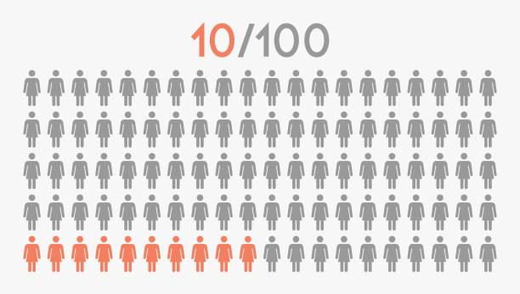
EVENT
AT RISK
Notes:
So as illustrated here, if we had 100 people with a Qrisk of 10%, we might expect to see 10 heart attacks or strokes over the next 10 years. Now, I going to ask you a couple of questions.

Slide 4
Notes:
And I want you to answer these questions by posting your answer using the chat button. Has everyone found this?

Slide 5
QUESTION:
HOW MANY OF THOSE 10 WHO HAD A HEART ATTACK HAD ATHEROSCLEROSIS?
Notes:
So a simple one to start with. How many of those 10 patients that had a cardiovascular event during that 10 year period had atherosclerosis?
Well, obviously it’s all of them, because to have an atherothrombotic event, it is necessary to have atherosclerosis.
The next question is a bit trickier……

Slide 6
QUESTION:
WHAT PROPORTION OF HEALTHY ASYMPTOMATIC PEOPLE IN THEIR MID 40’s HAVE ATHEROSCLEROSIS?
Notes:
If we took a group of people in their 40s to mid 50’s, with no history of cardiovascular disease, just ordinary people working at a bank’s headquarters……how many of them do you think w0uld have atherosclerosis? Again, pop your answers in using the chat button.

Slide 7
J Am Coll Cardiol. 2020 Apr, 75 (14) 1617–1627
Notes:
Well, here’s the answer. 60% of people had evidence of atherosclerosis, detectable either by 2DUltrasound, 3D ultrasound or Coronary calcium. And before you think what an unhealthy bunch, 45% of the participants had no CV risk factors at all. Indeed the average 10 year risk for the entire cohort was just under 2%. BTW, Coronary calcium was the least sensitive at detecting atherosclerosis, with it seen in only 17% of the population.So, there is a lot of atherosclerosis about. So if it is so common, why should we think about treating it?

Slide 8
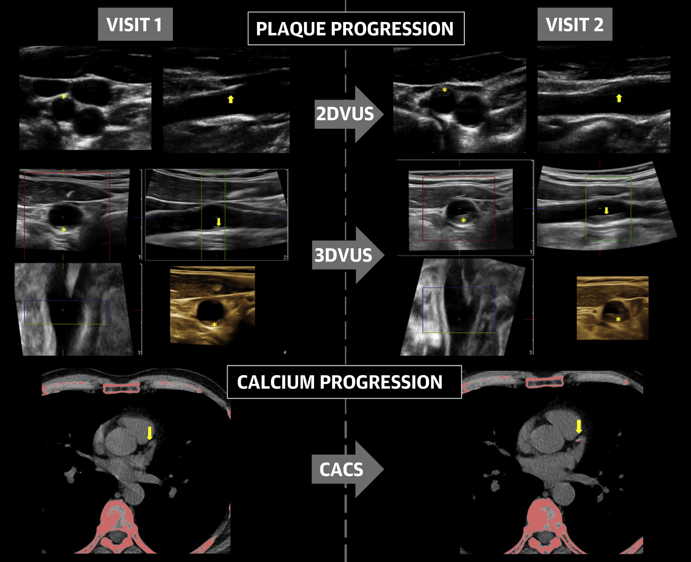
<5%
5-7.4%
>7.5%
Notes:
Well, this is what was seen at follow up after 3 years. There was progression of disease in over 40% of the population, with the greatest progression in those with the highest risk. Even in those with no disease at baseline, new lesions appeared in 30% of them. So what this tells us, is that although sub-clinical atherosclerosis is common by middle age, it then starts to progresses rapidly, particularly in those with traditional risk factors. And it is in the next decade, when these people are in the 50's and 60's that events start to happen.

Slide 9
TLHC
CAC
Notes:
Lets look then at our TLHC population. They are everyone over the age of 55 who has a history of smoking. If we put those risk factors into Qrisk, they will almost all have a 10 year risk of >10% so should already have been offered risk assessment and treatment with a statin. So it will come as absolutely no surprise that over 70% have evidence of CAC. And remember that CAC is not particularly sensitive, so an even higher percentage will have non-calcified atherosclerosis elsewhere.
Now for some good news…..over 80% of those with CAC are already on statin. Which is much higher than the overall population with a Qrisk of 10%, where only 56% are on a statin

Slide 10
TLHC
CAC
Notes:
So, we can see in orange here those with evidence of coronary atherosclerosis but who are not currently on a statin. So it makes absolute sense to target these people who have slipped through the net for primary prevention…..Firstly, because they should be on it anyway. Secondly, because they are at a point in life where they are thinking about their health and responding to screening offers so are likely to be receptive to change. And thirdly, because they are amongst the highest risk and already have the disease who’s consequences you are trying to prevent. So you will be getting excellent bang for you buck, both in terms of low effort and only a small number needed to treat to prevent an event.
But some of you may be thinking, wait a minute, this patient has coronary artery disease, they've got calcium blocking their arteries…..I have to see if they have chest pain…..we have to get them to a cardiologist straight away. Well, no.

Slide 11
J Am Coll Cardiol. 2020 Apr, 75 (14) 1617–1627
Notes:
Do you remember all these people working in the bank? Leading happy, healthy, asymptomatic lives, despite over 60% of them have atherosclerosis…..you wouldn’t suddenly call them up to see if they had chest pain would you?

Slide 12
CALCIUM
STENOSIS
Notes:
It’s important to remember that having atherosclerosis or seeing coronary calcium doesn’t mean your arteries are so narrowed that they will cause symptoms of angina, or claudication. Calcium does not equal stenosis, and stents are only good for treating stenosis. Stents do not prevent heart attacks. Lowering LDL-C, treating high BP, treating diabetes, taking regular exercise, stopping smoking……these are what prevent heart attacks in those who have atherosclerosis.
So the main messages I wanted to get across are atherosclerosis is common. You are not used to seeing it, but you are very used to treating it and trying to prevent it's worst consequences. All of the TLHC patients should be treated on their risk, not their CT results.
but let’s look now at what CT technology can show us…..

Slide 13
3D Lumen & Plaque Reconstructions
Lumen
Vessel
Calcium
QangioCT Cathlab Prototype, Medis Medical Imaging
Notes:
Here’s a CT of a patient’s coronary arteries. The lumen is shown in red, the vessel in green and calcium is shown in white. The right coronary here has some atherosclerosis within it, some of which contains calcium. The LAD has lots of calcium and lots of narrowing. Lets look at the right coronary in more detail

Slide 14
FFR_{CT} Assessment
RCA
Notes:
This is FFR CT which is measure based on computational fluid dynamics of whether a narrowing will affect blood flow. Blue and green is normal flow, red is abnormal flow.. So despite the atherosclerosis and calcium in the RCA, the flow is normal and the patient will have no symptoms from this artery.

Slide 15
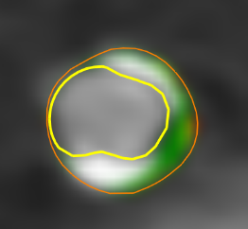
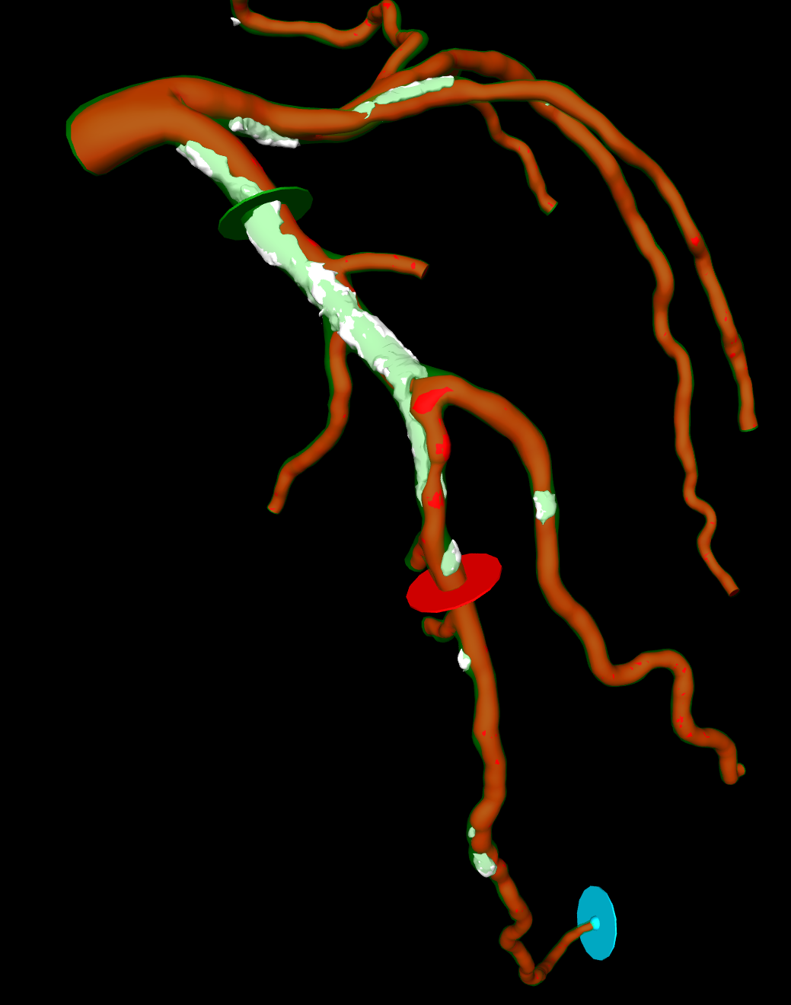
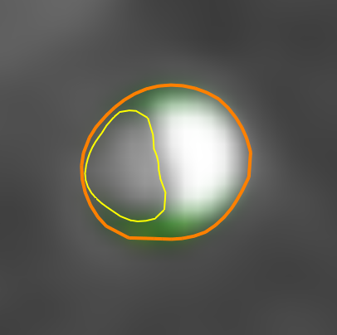
CT Plaque morphology and FFR_{CT}
3D reconstruction
FFRct
Lumen
Vessel
Calcium
Fibrous Fatty
Fibrous
Necrotic Core
Calcium
Notes:
In contrast, the long segment of calcific atherosclerosis in the LAD is causing significant impairment of blood flow in the areas where blue becomes red. This will almost certainly cause symptoms of angina, so a stent or a bypass graft might be helpuful in this area, to relieve those symptoms

Slide 16
Stenosis without Calcium
Notes:
This is a different patient’s right coronary artery. You can see that they don’t have any calcification, but they do have a severely narrowed artery with impairment of blood flow. In fact, this particular non-calcified narrowing is more likely to cause a heart attack than that calcified one we saw previously, because we can see it has a large necrotic core which is a feature of high risk plaque.

Slide 17
TLHC
CAC
Notes:
So, to reiterate again. What should we do with our TLHC patients? Well, the simple answer is anyone that you’ve invited for a TLHC scan, whose not already had a CVD risk assessment, should be called in for one, since they will all have a Qrisk of >10%. You don’t need the results of their CT scan for this. However, if they have had a CT and it does show CAC, then they will ABSOLUTELY benefit from having a CVD risk assessment and getting started on a statin. How to do this is all contained in the standard NICE guideline

Slide 18
Notes:
And if any of your patients, regardless of whether they have CAC or not, start to report chest pain then you should follow this guideline….

Slide 20
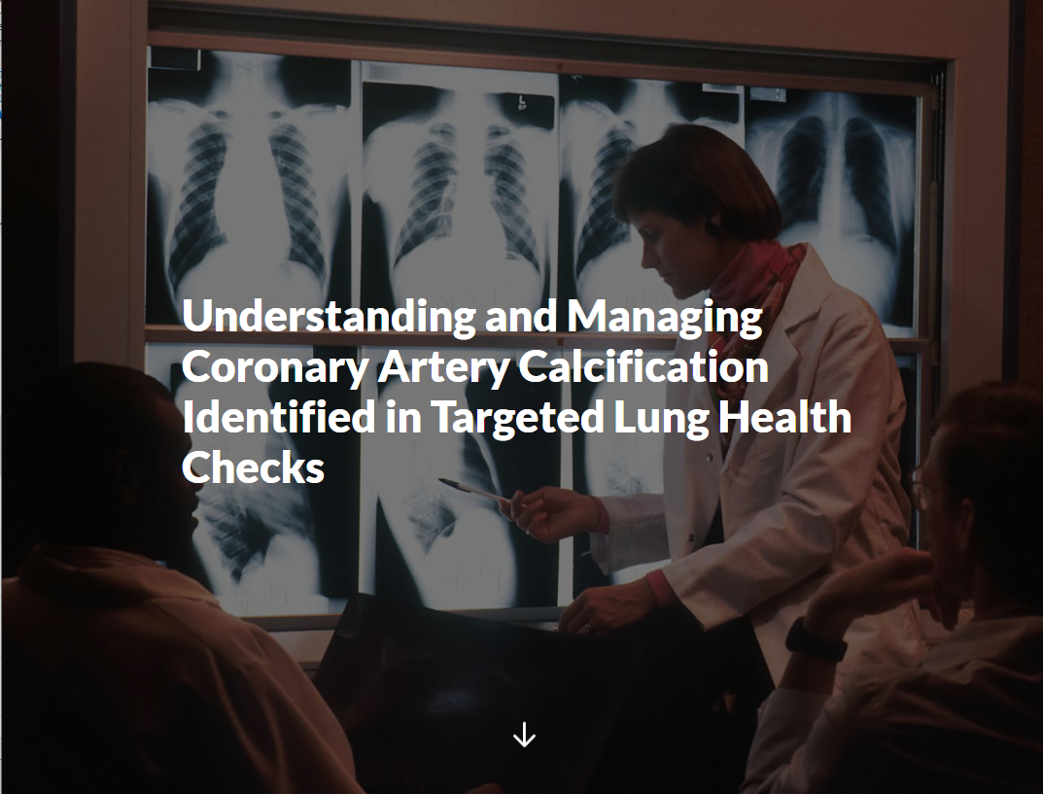
https://rise.articulate.com/share/Fa1HKRy_SDaU8WDpKvgGkmdzjTbqx9EG
Notes:
Now if you'd like more information, Chris Tasker and I have also produced a more detailed version with videos and information about what codes to use and which ones not to use. This is the link and QR code for these. To conclude then, assess and treat your patients on the basis of their Qrisk, not on the basis of their coronary calcium. For non TLHC patients, if you see they have CAC, then do the same but err on the side of lowering LDL-C, even if their Qrisk is <10%. Thank you

